Slide 1
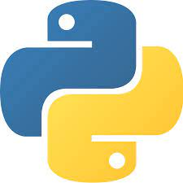
Lecture 0 INT108:: PROGRAMMING IN PYTHON (Program practice)

Slide 2
Course Overview
L T P :
Credit: 4
Text Book:
Fundamentals of Python –First Program Second edition by KENNETH A.LAMBERT,CENGAGE
References Book:
Python Programming: Using Problem solving approach by REEMA THAREJA, OXFORD UNIVERSITY PRESS
Introduction to Programming using Python by Y. DANIEL LIANG, PEARSON
3 | 0 | 2

Slide 3
Marks Breakup
Marks Breakup:
Activity | Marks
Attendance | 5
Continuous Assessment (CA)* | 65
End-Term Practical (ETP) | 30

Slide 4
CA and MTE
CA
Programming Practice using CodeTantra/ or EBox 40
Mini Project 15
Best 1 out of 2 MCQ Based Test 10
ETP
Programming Challenge/Hackathon based

Slide 5
Course Assessment Model
Programming Practice using E-Box/or Codetantra 40
Based on number of questions attempted
0-50% ->0 Marks
51% -> 1 Marks
74% ->24 Marks
90-100% -> 40 Marks
For each % of attempted question after 50%, student will be awarded 1 mark (max up to 45 marks)

Slide 6
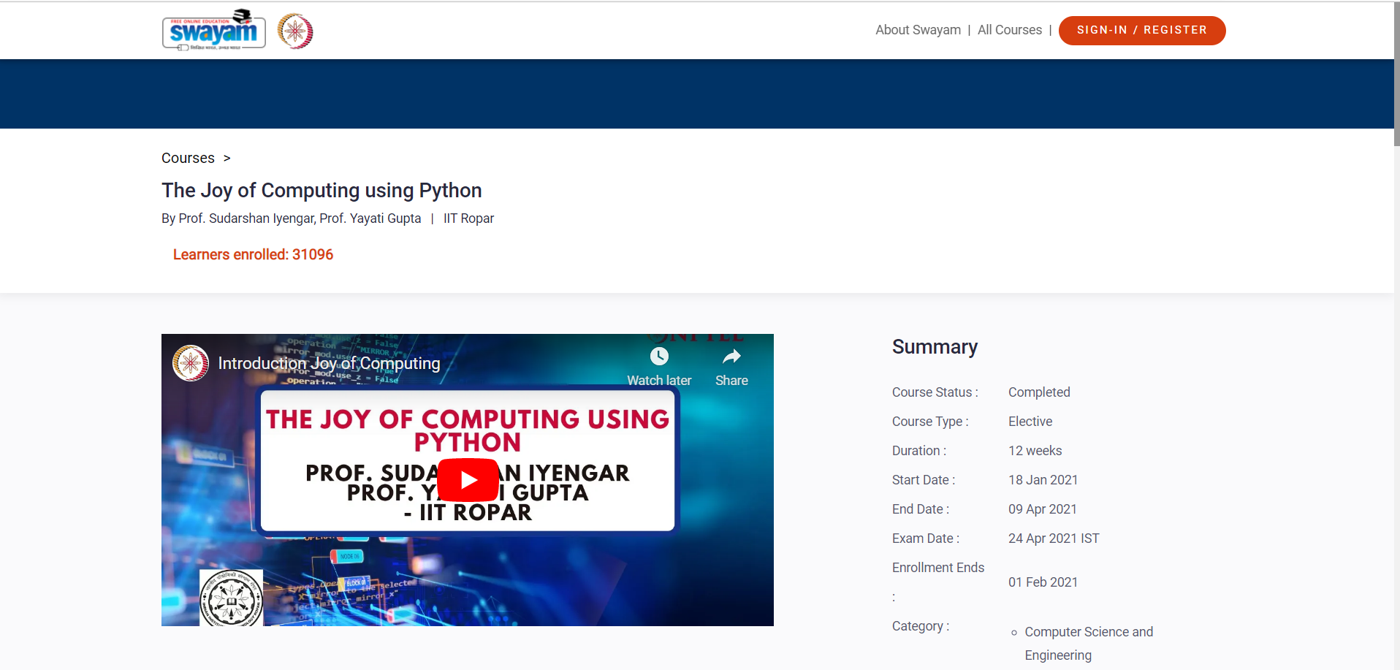
MOOC
https://onlinecourses.nptel.ac.in/noc21_cs32/preview
Exemptions:-
If student will provide the certificate,2 weeks prior to ETE then 1 CA will be exempted.

Slide 7
Course Outcomes
define the installation of python environment and basics of Python language.
apply the condition and iteration statements for evaluating the appropriate alternates.
apply to formulate Regular Expressions and use them for Pattern Matching .
construct the core data structures like lists, dictionaries, tuples and sets in Python to store, process and sort the data.
Apply the concepts of Object-oriented programming as used in Python using encapsulation, polymorphism, and inheritance .
Apply the external modules for creating and writing data to excel files and inspect the file operations to navigate the file systems.

Slide 8
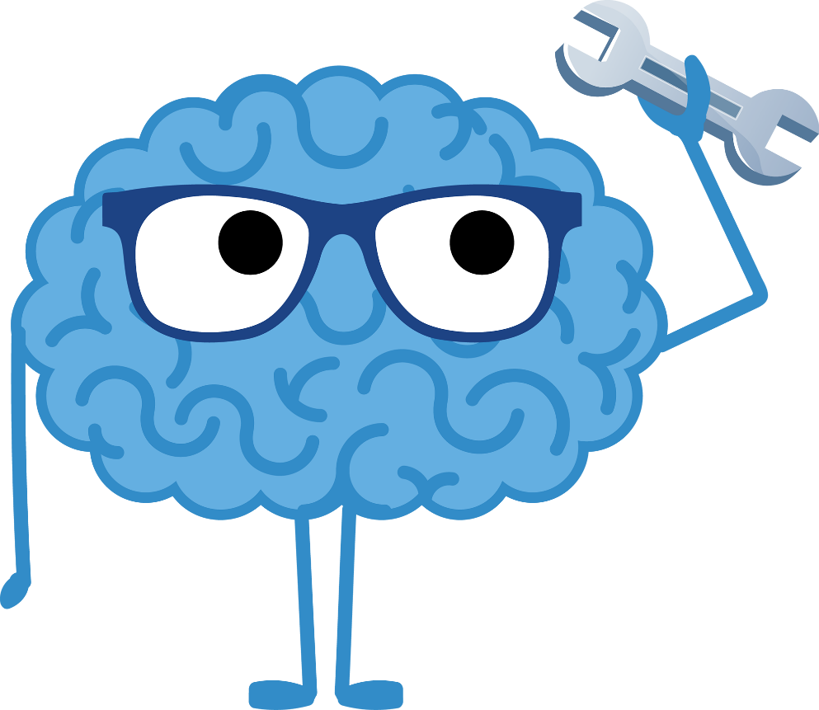
Why languages?

Slide 9
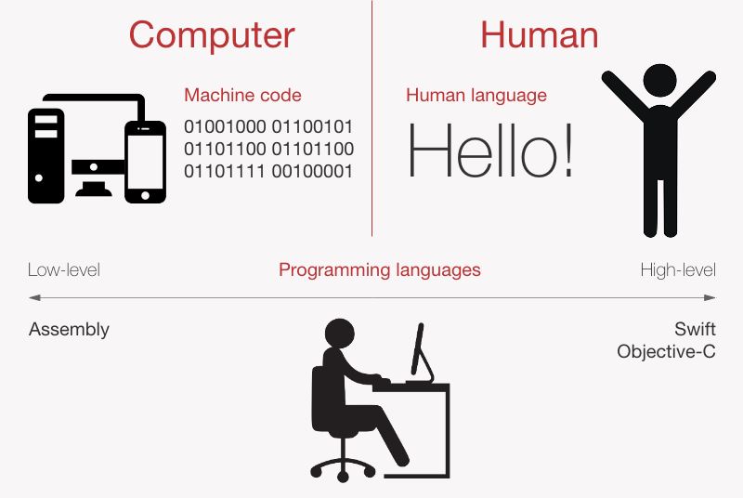
Computer Language vs. Human Language

Slide 10
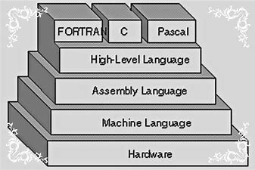
Different Computer Languages

Slide 11
Language Translators
Computers are electronic devices that can only understand machine-level binary code (0/1 or on/off), and it is extremely difficult to understand and write a program in machine language, so developers use human-readable high level and assembly instructions.
To bridge that gap, a translator is used, which converts high-level instructions to machine-level instructions (0 and 1).
The translator is a programming language processor that converts a high-level or assembly language program to machine-understandable low-level machine language without sacrificing the code's functionality.
There are 3 types:
1) Compiler
2) Interpreter
3) Assembler

Slide 12
Compiler
The compiler is a language translator program that converts code written in a human-readable language, such as high-level language, to a low-level computer language, such as assembly language, machine code, or object code, and then produces an executable program.
Characteristics of Compiler:
Source code is converted to machine code before runtime. So, code execution at runtime is faster.
Takes a lot of time to analyze and process the program. The compiling process is complicated.
But Program execution is Fast
Cannot create an executable program when there is a compile type error in the program.

Slide 13
Interpreter
The Interpreter's source code is transformed into machine code at run time. The compiler, however, converts the code to machine code, i.e. an executable file, before the program starts.
The interpreter program executes directly line by line by running the source code. So, it takes the source code, one line at a time, and translates it and runs it by the processor, then moves to the next line, translates it and runs it, and repeats until the program is finished.
Characteristics of Interpreter:
Spends less time converting to machine code.
No compilation stage is present in the interpreter while generating machine instructions.
Program execution is slower because it gets converted to machine code at runtime.
Easy for debugging and finding errors.

Slide 14
Compiler vs Interpreter
Compiler Compiler | Inte Interpreter
Translate High-level language program into machine code before runtime | Translate High-level language program into machine code at runtime
The compiler needs a lot of time for the whole source code to be analyzed | It takes less time for the source code to analyze
The overall program execution time is relatively faster. | Overall program execution time is relatively slower.
The compiler only generates an error message only after scanning the whole program. And all the errors are shown at the same time. | Interpreter only shows one error at a time and if solved and again after interpreting the code then shows the next error if exists.
Debugging is relatively more difficult since there can be an error anywhere in the code. | It is easier to debug since it continues to translate the program until the error is fixed. Show only one error at a time, and if solved then shows the next error if exists.
The compiler compiles the code before execution. | Compilation and execution take place simultaneously.
Difficult error detection and removal | Easy for error detection and removal
The programming language that uses Compiler: C, C++, C#, Scala | The programming language that uses Interpreters: Python, Perl, Ruby, PHP

Slide 15
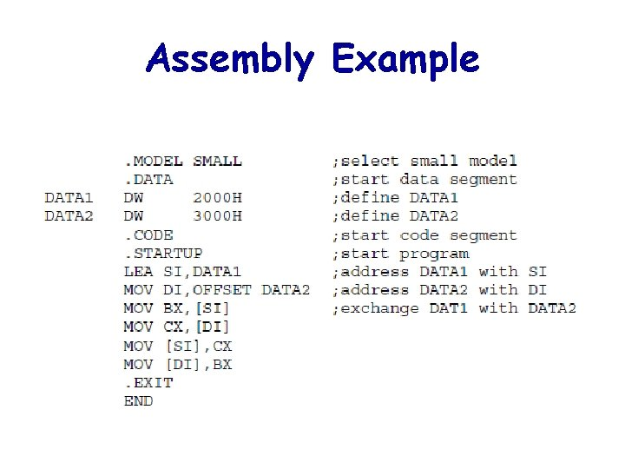
Assembler
Assembler converts code written in assembly language into machine-level code. Assembly language contains machine opcode mnemonics so that assemblers translate from mnemonics to machine code

Slide 16
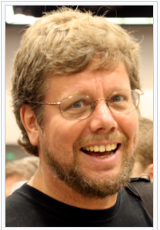
History of Python
Python is a widely-used general-purpose, high-level programming language. It was initially designed by Guido van Rossum in 1991(first release Python 0.9.0) and developed by Python Software Foundation.
It was mainly developed for emphasis on code readability, and its syntax allows programmers to express concepts in fewer lines of code.
Work on Python was started in the late 1980s by Guido van Rossum at Centrum Wiskunde & Informatica (CWI) in the Netherlands as a successor to the ABC programming language, which was inspired by SETL(Set language), capable of exception handling and interfacing with the Amoeba operating system. Its implementation began in December 1989.
Latest version: 3.10.6
Download link:
https://www.python.org/downloads/

Slide 17
Why Python
Python is a dynamic, high-level, free open source, and interpreted programming language. It supports object-oriented programming as well as procedural-oriented programming.
Following are some of the features:
Free and Open Source
Easy to code
Easy to read
Object Oriented language
GUI Programming Support
Easy to debug
It is a portable language
It is an integrated language
Large standard library
Dynamically typed language
Frontend and Backend development

Slide 18
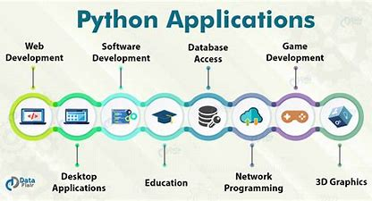

Slide 19
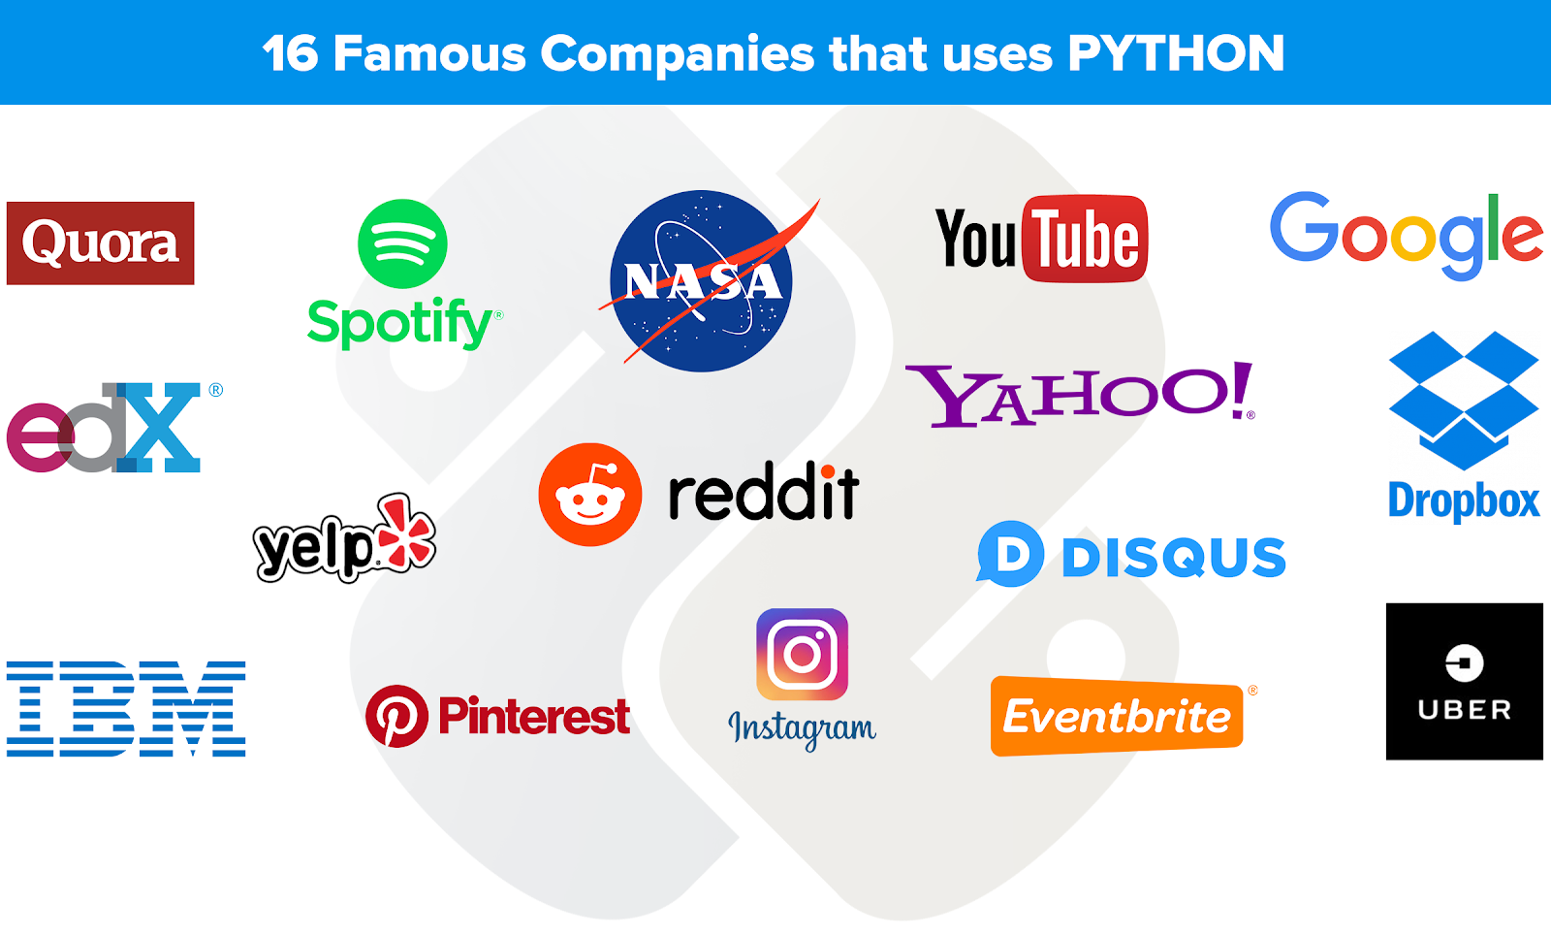

Slide 20
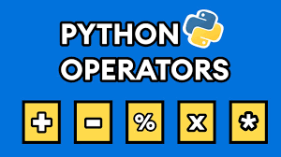
Overview of Unit 1

Slide 21
Unit 1
Setting up your Programming Environment: Python versions, Python on windows, running a ‘Hello World’ program
Variables, Expression and Statements: Naming and using variables, Avoiding Name Error when using variables, Values and types, variables, variables name and keywords, statements, operators and operand, order of operations, operations on string, composition and comments

Slide 22
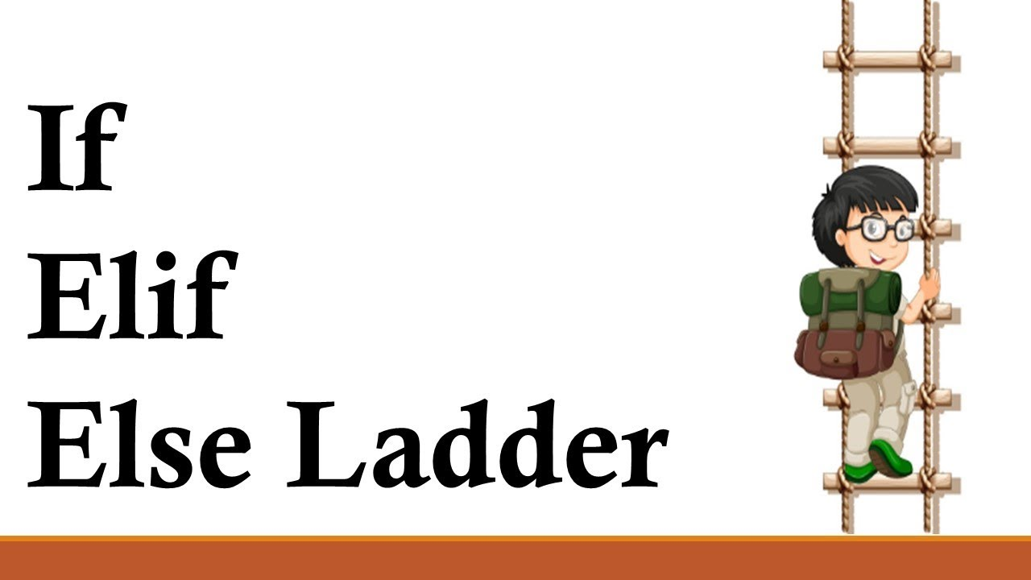
Overview of Unit 2

Slide 23
Unit 2
Conditional statements: modulus operator, Boolean expressions, logic operators, conditional, alternative execution, nested conditionals
Iterative statements: while statements, for loop statement, Nested for, Nested while, Random numbers in loops, encapsulation and generalization

Slide 24
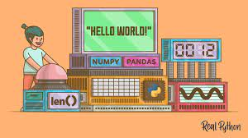
Overview of Functions and Recursion

Slide 25
Unit 3
Functions and recursion: function calls, type conversion and coercion, math functions, adding new function, parameters and argument, recursion and its use

Slide 26
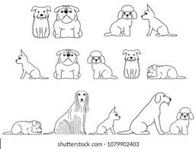
Lists and Tuples
LIST 1→
LIST2→
LIST3→

Slide 27
Unit 4
String: string a compound data type, length, string traversal, string slices, comparision, find function, looping and counting
Lists: list values, length, membership, operations, slices, deletion, accessing elements, list and for loops, list parameters and nested list.
Tuples and Dictionaries: mutability and tuples, tuple assignment, tuple as return values, dictionaries operations and methods, sparse matrices, aliasing and coping

Slide 28
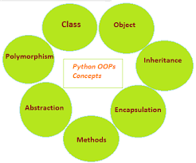
OOP

Slide 29
Unit 5
Classes and objects: Creating classes, creating instance objects, accessing attributes
Object oriented programming terminology: Class Inheritance, Overriding Methods, Data Hiding, Function Overloading

Slide 30
Unit 6
Files and Exceptions: text files, writing variables, Reading from a file, writing to a file, directories, pickling, handling the zero Division error exception, using try-except blocks, The else block, Handling the File Not found error exception
Regular Expressions – Concept of regular expression, various types of regular expressions, using match function, Web Scraping by using Regular Expressions

Slide 31
Different Python IDEs and Code Editors
IDE | Size in MB | Developed in
PyCharm | BIG | JAVA, PYTHON
Spyder | BIG | PYTHON
PyDev | MEDIUM | JAVA, PYTHON
Idle | MEDIUM | PYTHON
Wing | BIG | C, C++, PYTHON

Slide 32

Colaboratory, or "Colab" for short, allows you to write and execute Python in your browser, with
Zero configuration required
Free access to GPUs
Easy sharing

Slide 33


